Slide 2

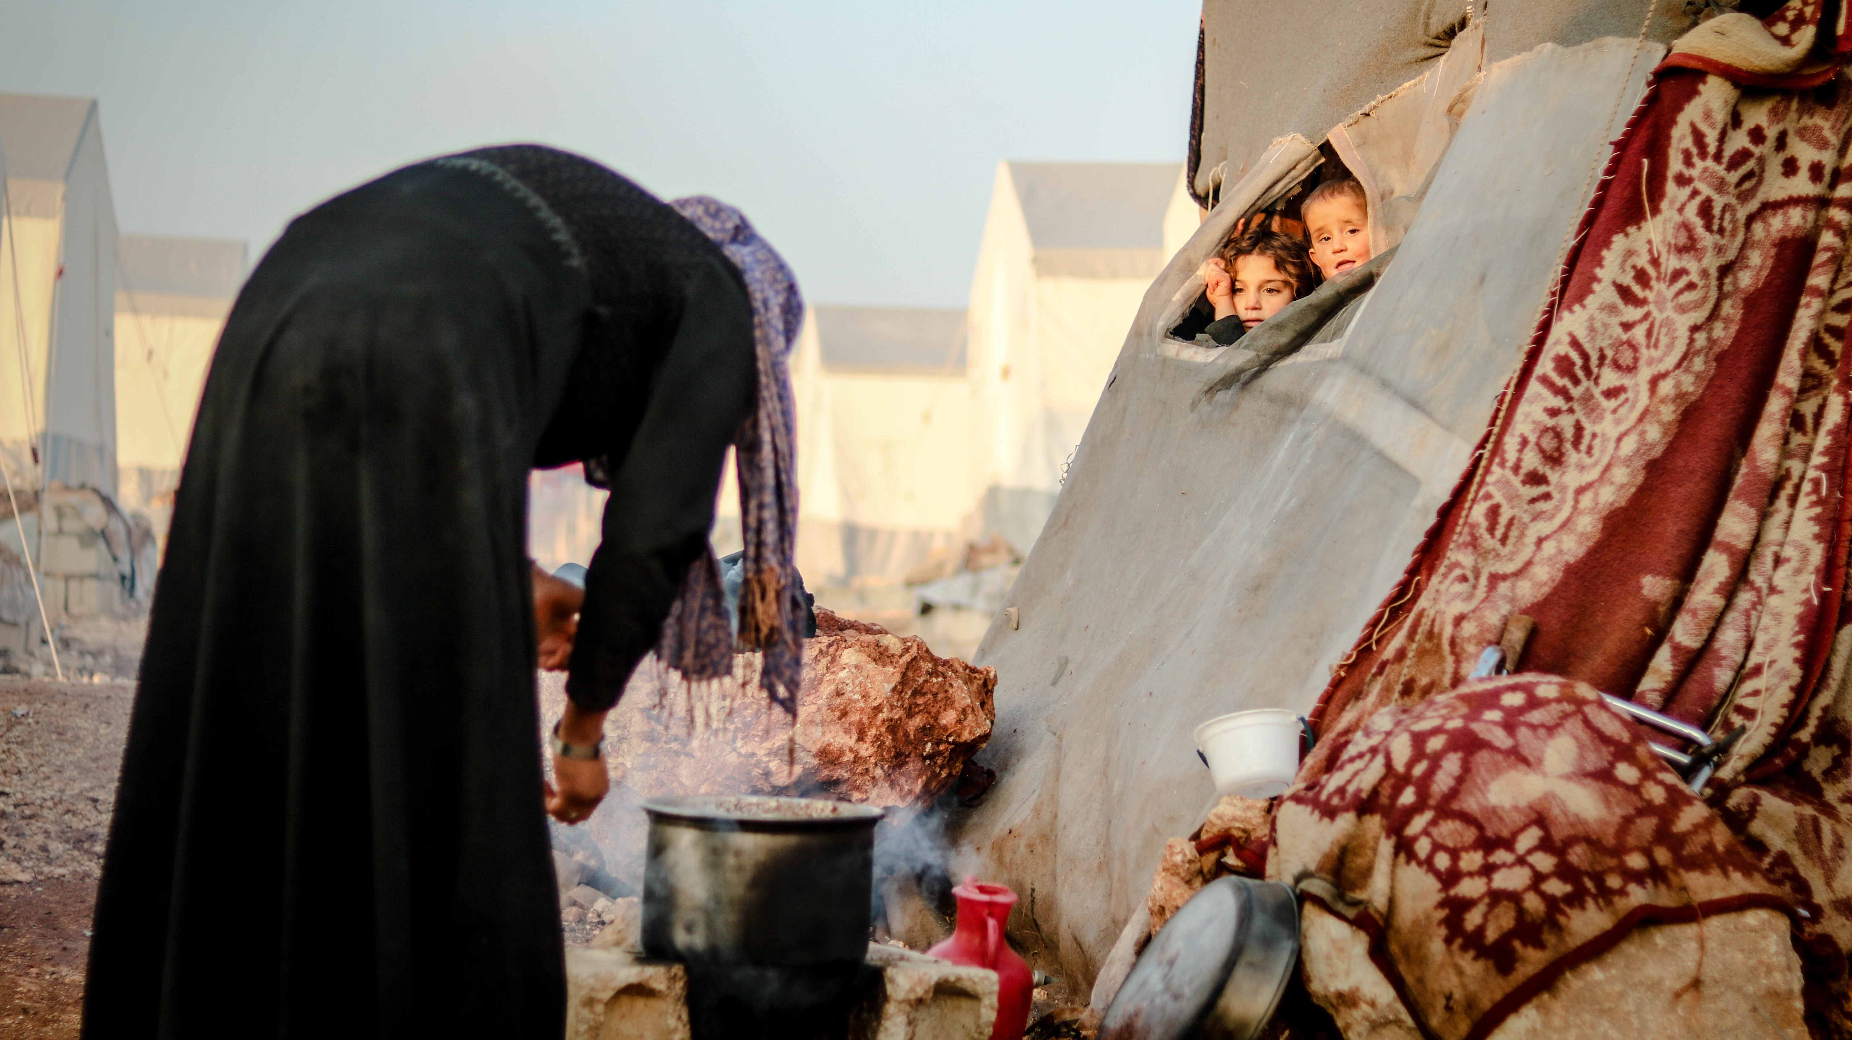

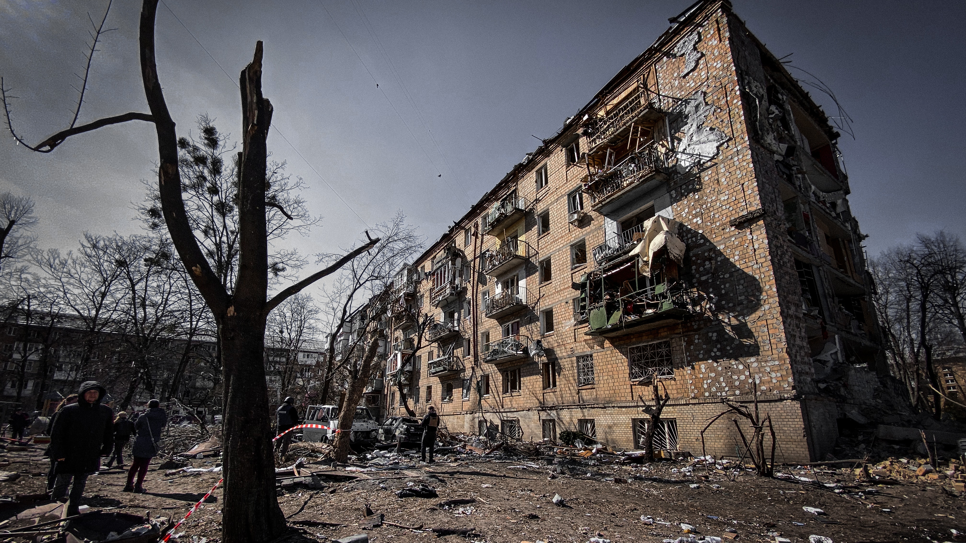
WAR

Slide 3

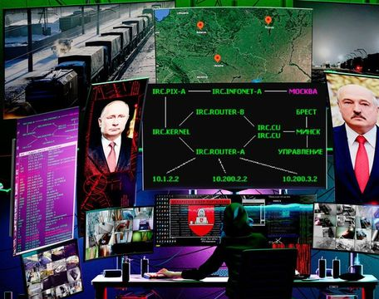
WAR

Slide 4
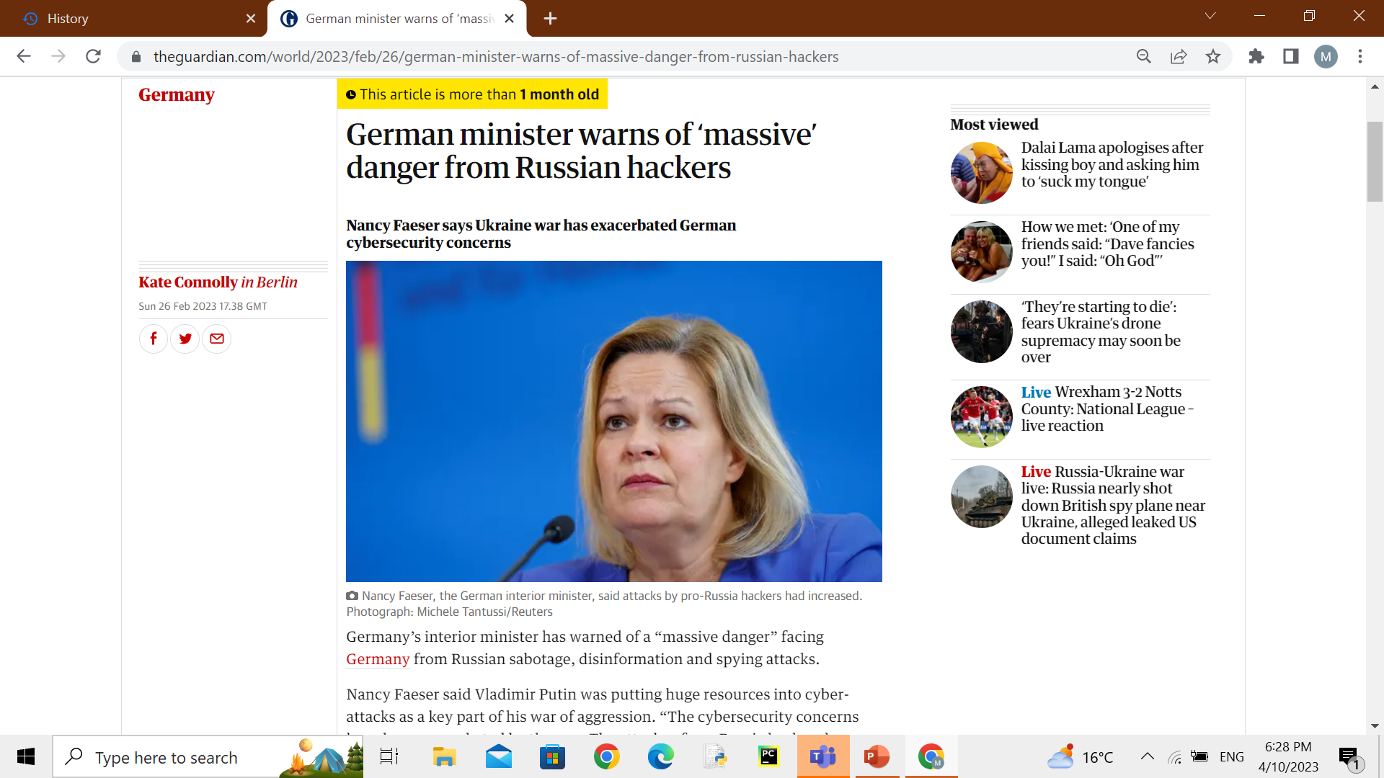
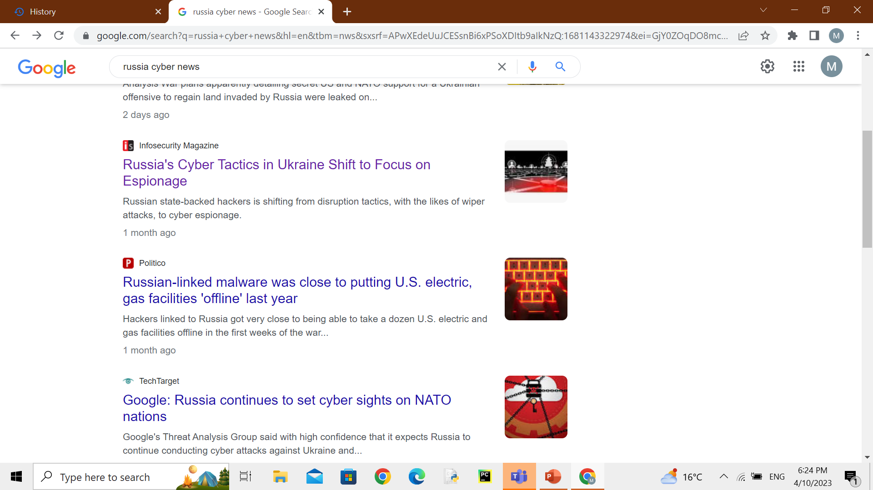
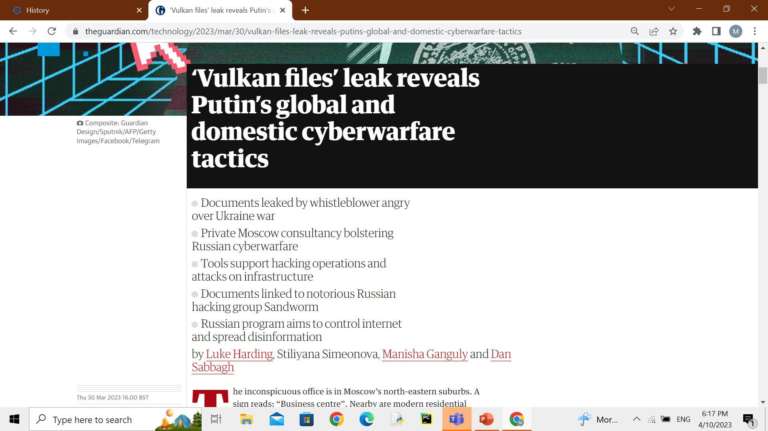
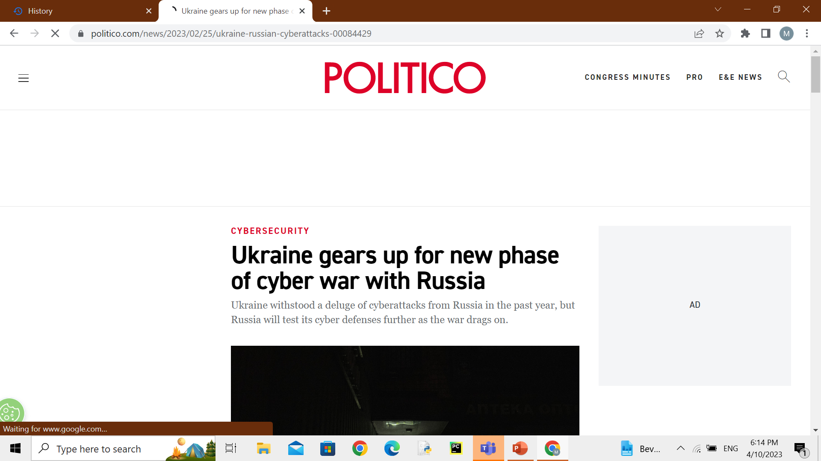
MODERN WAR

Slide 5


Slide 6

TOPIC: CYBERWAR
THE REIGN OF THE DIGITAL BATTLEFIELD
PRESENTED BY:
MANSI KONDEKAR
CLASS: INFORMATION AND COMMUNICATION (ITTM-11)

Slide 7
CONTENT
WHAT IS CYBER WARFARE?
HISTORY
TYPES OF CYBER WARFARE ATTACKS
HOW TO COMBAT CYBER WAR
IMAPCT OF CYBERWARFARE
FUTURE OF CYBERWARFARE
CONCLUSION: NEED FOR VIGILANCE

Slide 8
What is Cyberwar?

Slide 9
What is Cyberwar?
Cyber warfare is usually defined as a cyber attack or series of attacks that target a country by another.

Slide 10
What is Cyberwar?
Cyber warfare is usually defined as a cyber attack or series of attacks that target a country by another.
But in some cases, the attacks are carried out by terrorist organizations or non-state actors seeking to further the goal of a hostile nation.

Slide 11
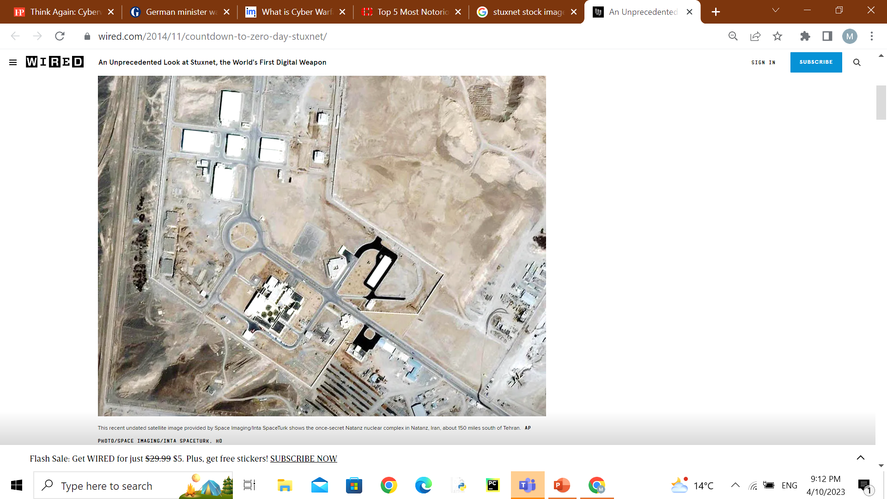
What is Cyberwar?
History
2010
Stuxnet
Cyber warfare is usually defined as a cyber attack or series of attacks that target a country by another.
But in some cases, the attacks are carried out by terrorist organizations or non-state actors seeking to further the goal of a hostile nation.

Slide 12
What is Cyberwar?
History
2010
Stuxnet
Cyber warfare is usually defined as a cyber attack or series of attacks that target a country by another.
But in some cases, the attacks are carried out by terrorist organizations or non-state actors seeking to further the goal of a hostile nation.
It is a powerful computer worm designed by U.S. and Israeli intelligence that to disable a key part of the Iranian nuclear program.
First uncovered in 2010 and thought to have been in development since early 2000s.
Stuxnet reportedly ruined almost one-fifth of Iran's nuclear centrifuges. Targeting industrial control systems, the worm infected over 200,000 computers and caused 1,000 machines to physically degrade.
.

Slide 13
What is Cyberwar?
2014
Russia launched a series of strategic attacks against Ukraine and the German parliament.
China hacked 21.5 million employee records, stealing information from the U.S. Office of Personnel Management.
Cyber warfare is usually defined as a cyber attack or series of attacks that target a country by another.
But in some cases, the attacks are carried out by terrorist organizations or non-state actors seeking to further the goal of a hostile nation.
2016
December 2016, the second Russian-caused power outage in Ukraine, losing about a fifth of Kievs power consumption that night affecting 225,000 people.

Slide 14
What is Cyberwar?
2017
The WannaCry attack impacted upwards of 200,000 computers in 150 countries. The attack targeted Windows computers with ransomware.
Later in 2017, the NotPetya attack, which originated in Ukraine, destroyed files, resulting in more than $10 billion in damage.
Cyber warfare is usually defined as a cyber attack or series of attacks that target a country by another.
But in some cases, the attacks are carried out by terrorist organizations or non-state actors seeking to further the goal of a hostile nation.

Slide 15
What is Cyberwar?
2022
The phones of Ukrainian officials have been targeted by hackers as Russia
Russian-backed separatists in a breakaway region of eastern Ukraine have blocked access to Google’s search engine, citing alleged disinformation.
Russia’s No. 2 bank VTB was hit by the largest cyberattack in its history, warning of temporary difficulties in accessing its mobile app and website
Cyber warfare is usually defined as a cyber attack or series of attacks that target a country by another.
But in some cases, the attacks are carried out by terrorist organizations or non-state actors seeking to further the goal of a hostile nation.

Slide 16
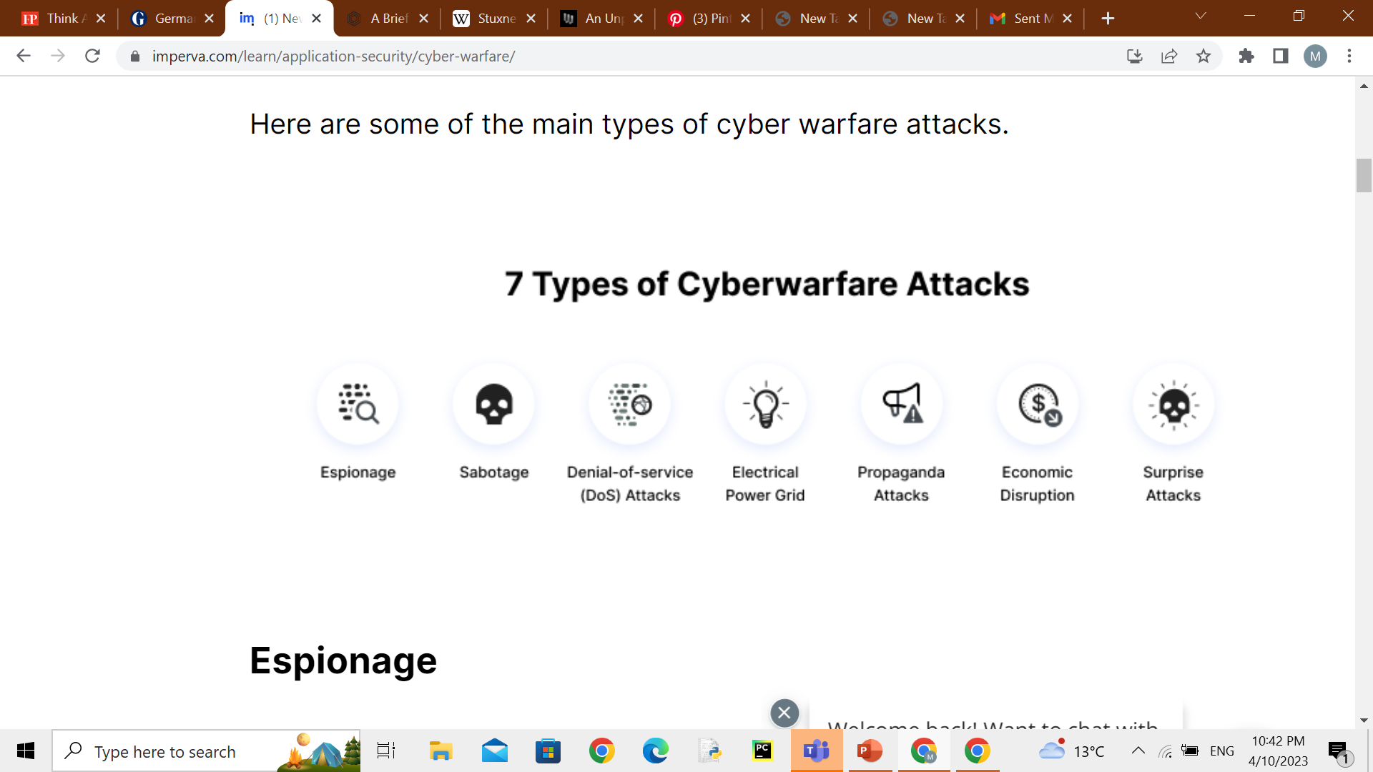
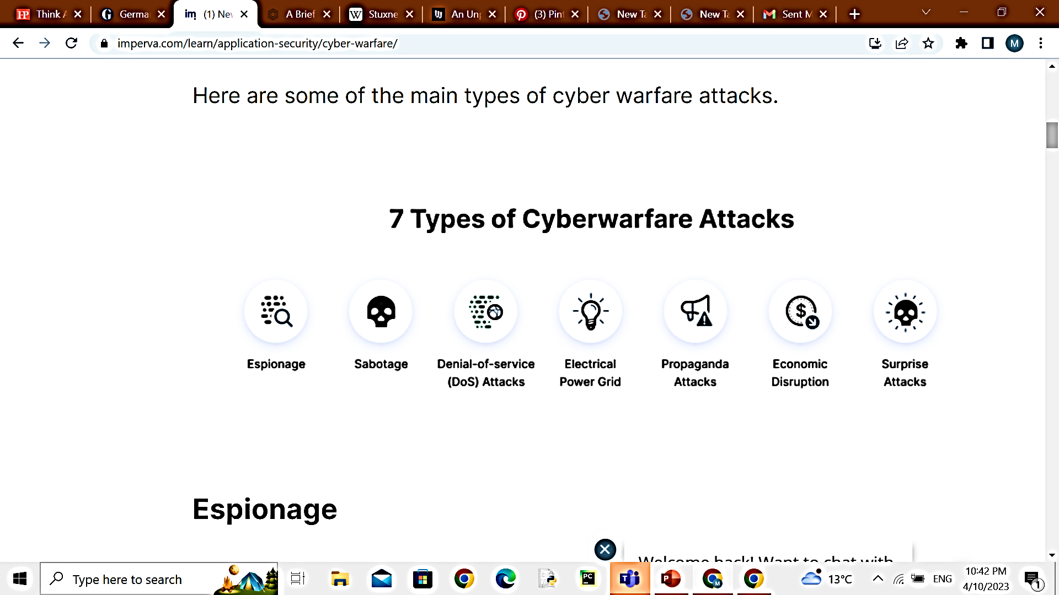
What is Cyberwar?
TYPES OF CYBER WARFARE ATTACKS
2017
The WannaCry attack impacted upwards of 200,000 computers in 150 countries. The attack targeted Windows computers with ransomware.
Later in 2017, the NotPetya attack, which originated in Ukraine, destroyed files, resulting in more than $10 billion in damage.
Cyber warfare is usually defined as a cyber attack or series of attacks that target a country by another.
But in some cases, the attacks are carried out by terrorist organizations or non-state actors seeking to further the goal of a hostile nation.

Slide 17
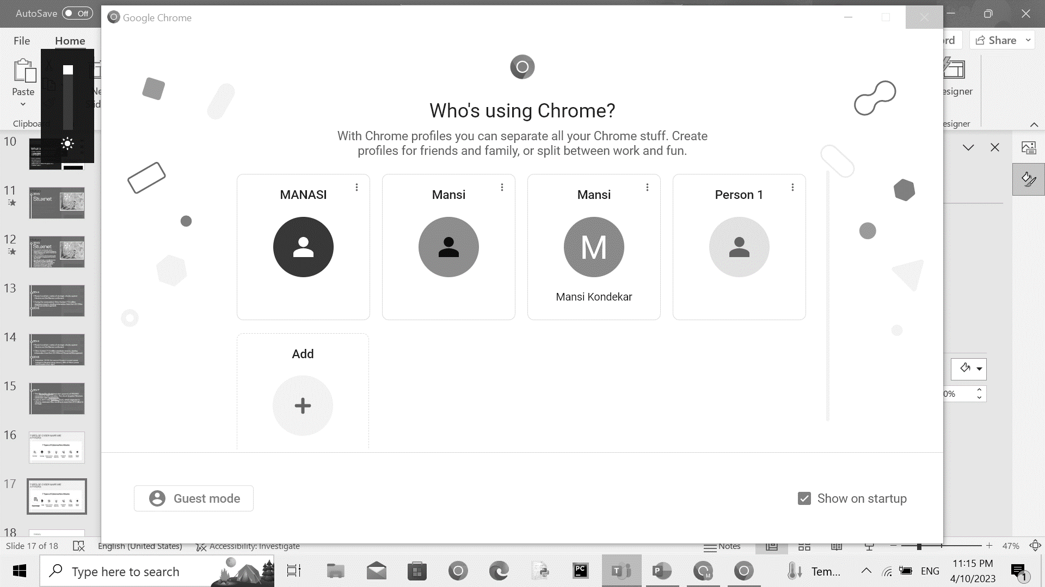

What is Cyberwar?
TYPES OF CYBER WARFARE ATTACKS
2017
The WannaCry attack impacted upwards of 200,000 computers in 150 countries. The attack targeted Windows computers with ransomware.
Later in 2017, the NotPetya attack, which originated in Ukraine, destroyed files, resulting in more than $10 billion in damage.
Cyber warfare is usually defined as a cyber attack or series of attacks that target a country by another.
But in some cases, the attacks are carried out by terrorist organizations or non-state actors seeking to further the goal of a hostile nation.
Refers to monitoring other countries to steal secrets.
Involve using botnets or spear phishing attacks to compromise sensitive computer systems before exfiltrating sensitive information.

Slide 18
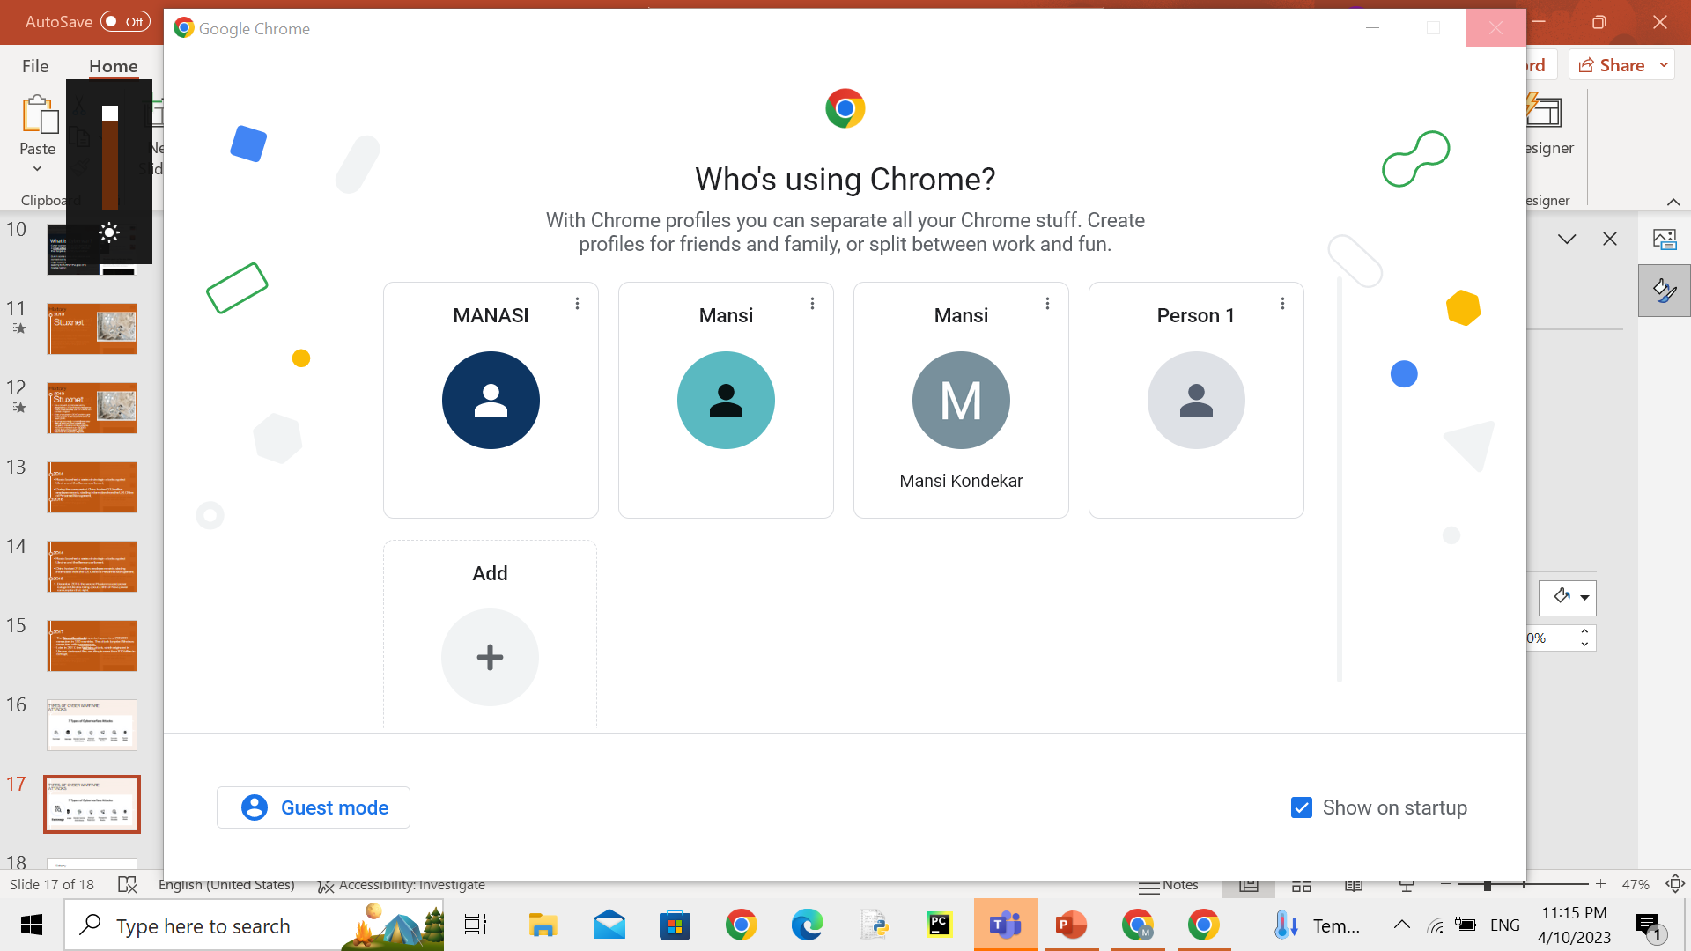
What is Cyberwar?
TYPES OF CYBER WARFARE ATTACKS
2017
The WannaCry attack impacted upwards of 200,000 computers in 150 countries. The attack targeted Windows computers with ransomware.
Later in 2017, the NotPetya attack, which originated in Ukraine, destroyed files, resulting in more than $10 billion in damage.
Cyber warfare is usually defined as a cyber attack or series of attacks that target a country by another.
But in some cases, the attacks are carried out by terrorist organizations or non-state actors seeking to further the goal of a hostile nation.
Government organizations must determine sensitive information and the risks if it is compromised.

Slide 19
What is Cyberwar?
TYPES OF CYBER WARFARE ATTACKS
2017
The WannaCry attack impacted upwards of 200,000 computers in 150 countries. The attack targeted Windows computers with ransomware.
Later in 2017, the NotPetya attack, which originated in Ukraine, destroyed files, resulting in more than $10 billion in damage.
Cyber warfare is usually defined as a cyber attack or series of attacks that target a country by another.
But in some cases, the attacks are carried out by terrorist organizations or non-state actors seeking to further the goal of a hostile nation.
Prevent legitimate users from accessing a website by flooding it with fake requests and forcing the website to handle these requests.
This type of attack can be used to disrupt critical operations and systems and block access to sensitive websites by civilians, military, security personnel, or research bodies.

Slide 20
What is Cyberwar?
Attacking the power grid allows attackers to disable critical systems,
disrupt infrastructure, and potentially result in bodily harm. Attacks
TYPES OF CYBER WARFARE ATTACKS
2017
The WannaCry attack impacted upwards of 200,000 computers in 150 countries. The attack targeted Windows computers with ransomware.
Later in 2017, the NotPetya attack, which originated in Ukraine, destroyed files, resulting in more than $10 billion in damage.
Cyber warfare is usually defined as a cyber attack or series of attacks that target a country by another.
But in some cases, the attacks are carried out by terrorist organizations or non-state actors seeking to further the goal of a hostile nation.
Attacking the power grid allows attackers to disable critical systems, disrupt infrastructure, and potentially result in bodily harm.

Slide 21
What is Cyberwar?
TYPES OF CYBER WARFARE ATTACKS
2017
The WannaCry attack impacted upwards of 200,000 computers in 150 countries. The attack targeted Windows computers with ransomware.
Later in 2017, the NotPetya attack, which originated in Ukraine, destroyed files, resulting in more than $10 billion in damage.
Cyber warfare is usually defined as a cyber attack or series of attacks that target a country by another.
But in some cases, the attacks are carried out by terrorist organizations or non-state actors seeking to further the goal of a hostile nation.
Attempts to control the minds and thoughts of people living in or fighting for a target country.
Propaganda can be used to expose embarrassing truths, spread lies to make people lose trust in their country, or side with their enemies.

Slide 22
What is Cyberwar?
TYPES OF CYBER WARFARE ATTACKS
2017
The WannaCry attack impacted upwards of 200,000 computers in 150 countries. The attack targeted Windows computers with ransomware.
Later in 2017, the NotPetya attack, which originated in Ukraine, destroyed files, resulting in more than $10 billion in damage.
Cyber warfare is usually defined as a cyber attack or series of attacks that target a country by another.
But in some cases, the attacks are carried out by terrorist organizations or non-state actors seeking to further the goal of a hostile nation.
Attackers can target computer networks of economic establishments such as stock markets, payment systems, and banks to steal money or block people from accessing the funds they need.

Slide 23
What is Cyberwar?
TYPES OF CYBER WARFARE ATTACKS
2017
The WannaCry attack impacted upwards of 200,000 computers in 150 countries. The attack targeted Windows computers with ransomware.
Later in 2017, the NotPetya attack, which originated in Ukraine, destroyed files, resulting in more than $10 billion in damage.
Cyber warfare is usually defined as a cyber attack or series of attacks that target a country by another.
But in some cases, the attacks are carried out by terrorist organizations or non-state actors seeking to further the goal of a hostile nation.
These are the cyber equivalent of attacks like Pearl Harbor and 9/11. The point is to carry out a massive attack that the enemy is not expecting, enabling the attacker to weaken their defenses. This can be done to prepare the ground for a physical attack in the context of hybrid warfare.

Slide 24
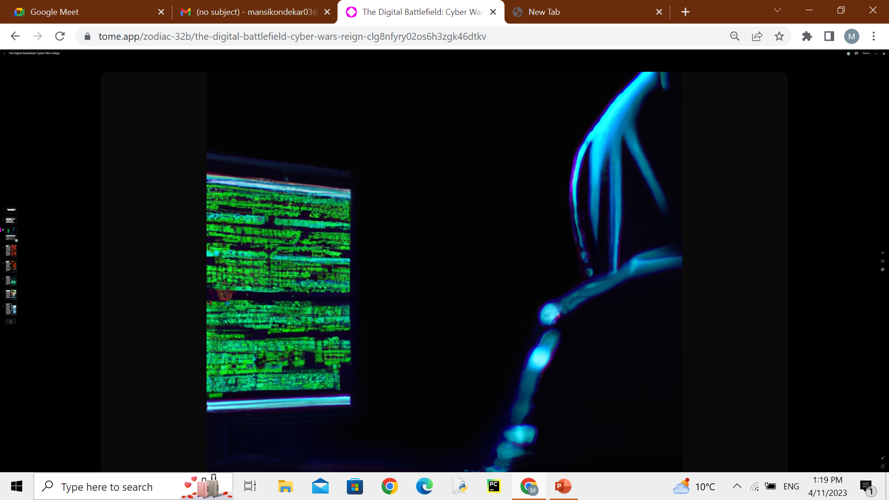
What is Cyberwar?
TYPES OF CYBER WARFARE ATTACKS
HOW TO COMBAT CYBER WAR
2017
Conducting Risk Assessments with Cyber Wargames
The WannaCry attack impacted upwards of 200,000 computers in 150 countries. The attack targeted Windows computers with ransomware.
Later in 2017, the NotPetya attack, which originated in Ukraine, destroyed files, resulting in more than $10 billion in damage.
Cyber warfare is usually defined as a cyber attack or series of attacks that target a country by another.
But in some cases, the attacks are carried out by terrorist organizations or non-state actors seeking to further the goal of a hostile nation.
The best way to assess a nations readiness for cyber warfare is to conduct a real-life exercise or simulation, also known as a cyber wargame.
A wargame can test how governments and private organizations respond to a cyber warfare scenario, expose gaps in defenses, and improve cooperation between entities.

Slide 25
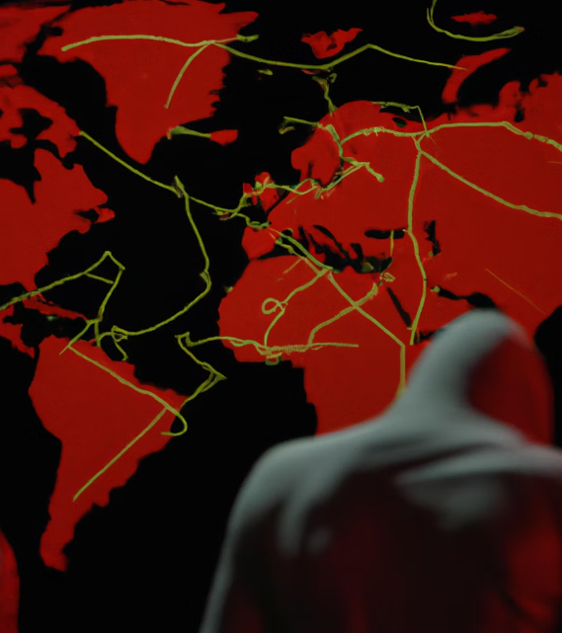
The Impacts of Cyber Warfare
The impacts of cyber warfare can be devastating. In addition to causing physical damage to infrastructure, cyber attacks can also result in the theft of sensitive information and intellectual property. This can have serious economic and national security consequences for a country.
Cyber attacks can also have psychological impacts, causing fear and uncertainty among the population. They can erode trust in government and institutions and create a sense of vulnerability among citizens.

Slide 26
HOW TO COMBAT CYBER WAR
Conducting Risk Assessments with Cyber Wargames
The best way to assess a nations readiness for cyber warfare is to conduct a real-life exercise or simulation, also known as a cyber wargame.
A wargame can test how governments and private organizations respond to a cyber warfare scenario, expose gaps in defenses, and improve cooperation between entities.

Slide 27
The Importance of Layered Defense
These policies typically use a layered defense approach, which includes:
Securing the cyber ecosystem
Raising awareness for cybersecurity
Promoting open standards for combating cyber threats
Implementing a national cybersecurity assurance framework
Working with private organizations to improve their cybersecurity capabilities

Slide 28

Securing the Private Sector
A strategic factor in cyberwarfare is the resilience of local businesses to cyber attacks.
The following is a set of measures to ensure corporate cybersecurity, which can promote national security:
Create obstacles to breaching the network
Use web application firewalls (WAF) to quickly detect, investigate, and block malicious traffic
Quickly respond to a breach and restore business operations
Facilitate cooperation between the public and private sectors
Use local hackers as a resource to help protect against foreign cyber threats

Slide 29
The Future of Cyber Warfare
As technology continues to advance, the future of cyber warfare looks increasingly complex and unpredictable. Net technologies, such as artificial intelligence and the Internet of Things, will create new vulnerabilities that attackers can exploit. At the same time, defenders will also have access to new tools and techniques to protect against these attacks.
One thing is clear: cyber warfare is here to stay. As long as there are computers and networks, there will be those who seek to exploit them for their own purposes. It is up to governments, businesses, and individuals to work together to develop effective strategies to defend against these threats.

Slide 30
Conclusion: The Need for Vigilance
In conclusion, cyber warfare is a growing threat that requires constant vigilance and attention. Governments, businesses, and individuals must all take steps to protect themselves against cyber attacks. This includes investing in cybersecurity measures, educating employees about the risks of cyber attacks, and staying up-to-date on the latest threats and vulnerabilities.
Only by working together can we hope to mitigate the risks posed by cyber warfare and ensure a safe and secure digital future for us all.

Slide 31
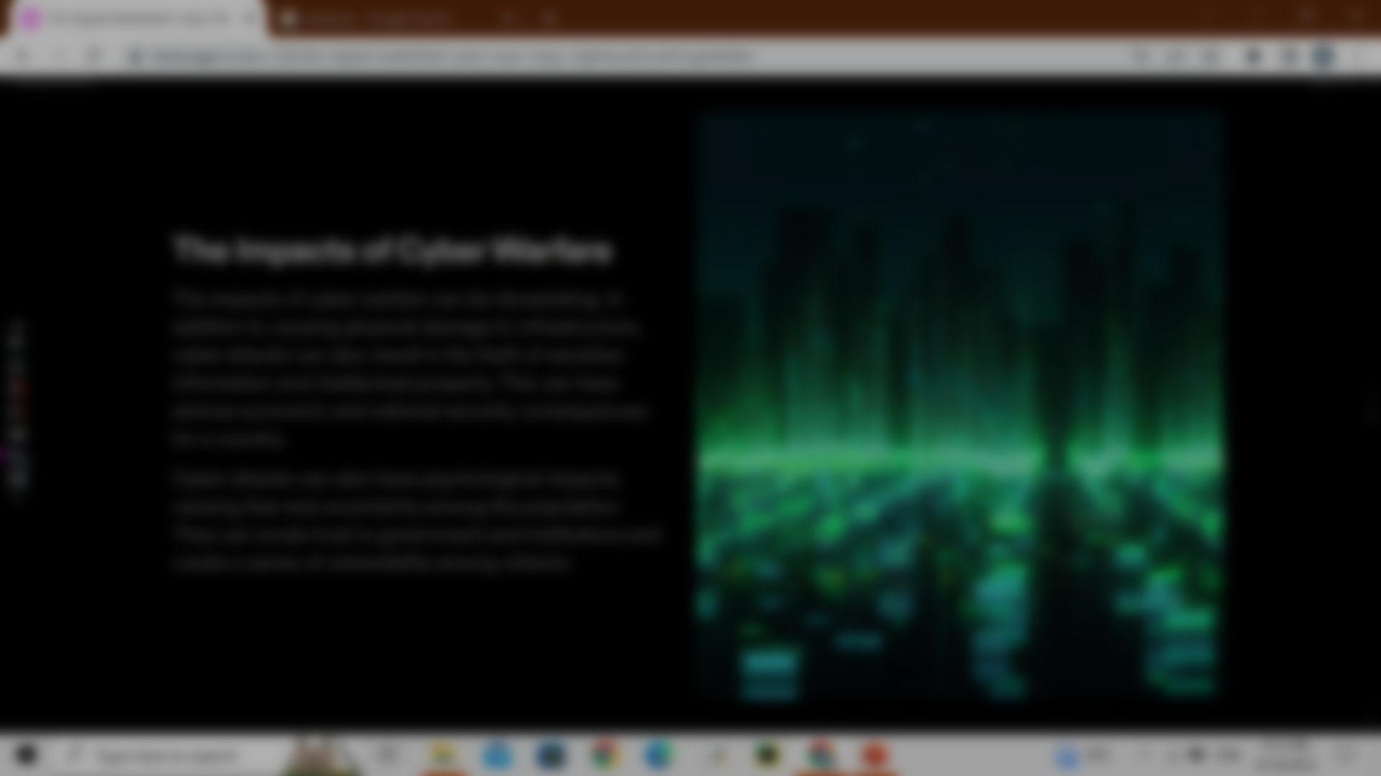
Reference
https://www.imperva.com/learn/application-security/cyber-warfare/
https://www.wired.com/2014/11/countdown-to-zero-day-stuxnet/
https://en.wikipedia.org/wiki/Stuxnet
http://www.ethikundmilitaer.de/en/full-issues/20191-conflict-zone-cyberspace/von-wussow-cyberwar-past-and-present-of-a-contested-term/
https://www.theguardian.com/world/2023/feb/26/german-minister-warns-of-massive-danger-from-russian-hackers
https://www.theguardian.com/technology/2023/mar/30/vulkan-files-leak-reveals-putins-global-and-domestic-cyberwarfare-tactics
https://www.thalesgroup.com/en/group/news/war-ukraine-new-geography-cyber-warfare
https://foreignpolicy.com/2012/02/27/think-again-cyberwar/

